Slide 1
CS4499/5599: Data Science and Applied Machine Learning
Class Lecture: February 27th, 2023

Slide 2
Objectives
Last time:
A.I Vs. Machine Learning
Applications
4 Types of Machine Learning Models
Today:
Challenges of Machine Learning
The Machine Learning process

Slide 3
Challenges of Machine Learning
Machine learning has grown exponentially in the last decade
However, there are issues data scientist have to consider when using these tools
In machine learning there are two things that can go wrong for a data scientist
“Bad” algorithms
“Bad” data

Slide 4
Challenges of Working with Data
Everything we do regarding machine learning depends on data
If you have an issue with your data, you will likely have issues with your model
Common issues with data include:
Insufficient Quantity of Training Data
Nonrepresentative Training Data
Poor Quality Data
Irrelevant Features
Overfitting/Underfitting Training Data

Slide 5
Insufficient Quantity of Training Data
First consider how we as humans learn
When we are young, we generally learn through repetition
If we show an infant an apple and tell them its an apple, over time they will learn what makes an apple and apple
Things like color, shape, taste, feel, smell, etc.
This is not the case with machine learning (yet)

Slide 6
Insufficient Quantity of Training Data
A machine learning model needs lots of data to learn how to distinguish different things
For example, if we want to make an image classifier, we might need hundreds if not thousands of images
In some cases, we might need millions or more data points to make an effective classification
If we don’t have enough data, our models won’t be able to learn and will be low quality
Now how much data is enough?

Slide 7
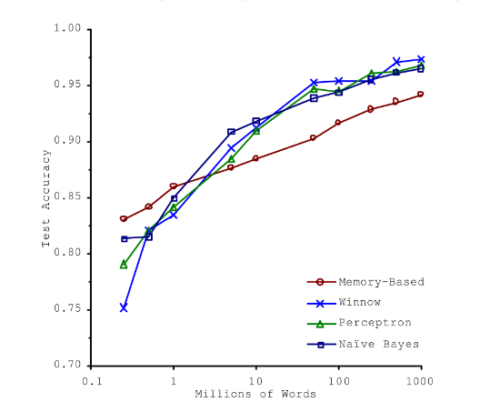
“The Unreasonable Effectiveness of Data “
Source: Microsoft Researchers Michele Banko and Eric Brill

Slide 8
Nonrepresentative Training Data
A key to remember that the purpose of ML models is to eventually use them with new data
If our dataset if non-representative of the actual goal of our model, we will likely get models that look good and then perform bad in practice
Let’s consider an example from the Geron book

Slide 9
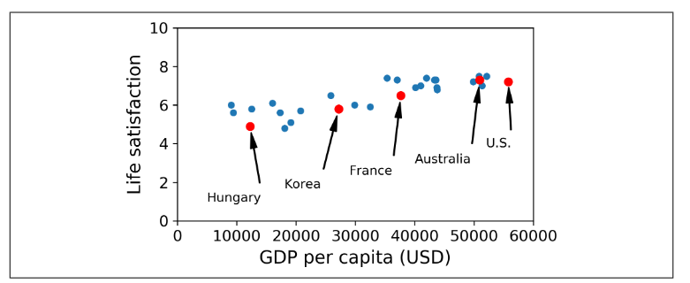
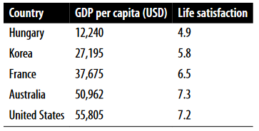
Nonrepresentative Training Data
If we consider a simple linear regression model what does this tell us?

Slide 10
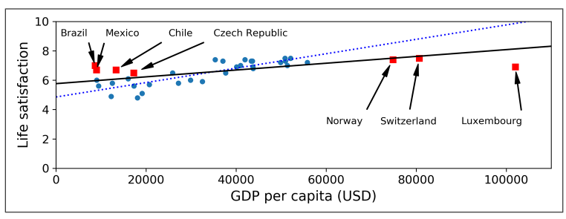
Nonrepresentative Training Data
Now let’s test our model with some other countries
What do you notice?

Slide 11
Nonrepresentative Training Data
Dealing with this is actually very difficult
It come down to how you collect your data
Data collection is likely the hardest thing in data science
A few considerations:
Ensure adequate sample size
Document the sampling technique (prevent and address sample bias)

Slide 12
Poor Quality Data
Another common problem in data science is poor quality data
But what does this actually mean?
Poor quality data has one or more of the following attributes:
Data contains several outliers (or noise)
Data is missing one or more features (dimensions)
Data with these issues will make it more difficult for your model to make accurate predictions
We will discuss strategies to help deal with these issues very soon

Slide 13
Irrelevant Features
Another major consideration for your data is the attributes of your data
If the data is full of features that are irrelevant to the questions you want to answer, your model will suffer
Selecting what features your model uses is a major part of being a data scientist, this is called feature engineering
Feature Engineering entails:
Feature selection, find relevant features
Feature extraction, combining features to create more powerful ones
Data collection with new features

Slide 14
Overfitting Data
As human we have a tendency over generalize cases
Machines can fall into this trap just as easily as humans
This is known as model overfit
When a model is overfit, it may seem like a good model, but in reality, it is just over generalizing
In machine learning it is very common that models are overfit, in order for your model to be effective you need to address overfit

Slide 15
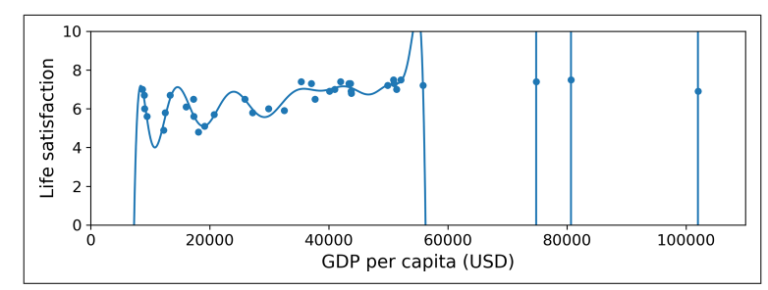
Overfitting Data
Assume we have developed a polynomial equation for the example from Geron
Do you think this will be very useful as we test new data with the model?

Slide 16
Overfitting Data
Machine learning models, especially more advanced neural networks, look to identify patterns
If there is noise or the dataset is too small the model will just generalize these patterns
When this happens, it is unlikely our model will be able to work with new instances
Overfitting can occur if our data is too complex (i.e. we have too many features)
Models can find patterns in these irrelevant models, which will degrade performance, this is called the “Curse of Dimensionality”

Slide 17
Addressing Overfitting Data
When you find your model is overfit, there are some strategies we can use to help reduce the impact
Simplify the model (ex: try a linear model vs a high degree polynomial)
Simplify the model by reducing the number of features
Collect more data
Reduce noise in the training data by addressing major outliers and missing values
Constrain the model using regularization

Slide 18
Underfitting Data
At this point it you have probably guess underfitting is just the opposite of overfitting
In these cases, our model is too simple, and it cannot learn the overall structure of the data or cannot identify meaningful patters
This is very test and spot, as the model will just yield poor results when tested
Strategies to fix this problem include:
Selecting a more “powerful” model with more parameters
Use feature engineering to create better features
Reduce any constraints placed on the model

Slide 19
Other Considerations for Machine Learning
When working with machine learning there are a number of other considerations we should consider
Computation Time
Is this a process where machine learning should be applied
Are there risk associated with the application

Slide 20
Computation Time
Machine learning models (and the data we use) can be simple or complex
As the complexity increases the time and power needed to train models also increases
Data sets can have millions (or more) parameters, and the more parameters our data has the longer it will take to train a model
In this class, the models we should little or no problem training models, but as your go further into data science, this will become a more pressing concern

Slide 21
Knowing when to Apply a ML Model
Due to the current excitement of the possibilities in machine learning, people are exploring different possibilities
Many organizations have explored the use of machine learning for things like resume filtering
The idea is to see if they can find the “perfect” candidates for positions
This practice has gone under a lot of scrutiny, and there have been claims that the models treat some groups unfairly
When deciding if a machine learning model is an approach for a problem, make sure to ask yourself is this a task for a machine or a person to do

Slide 22
Automation and Managing Risk
Another major application for machine learning is automation
One of the “dreams” of machine learning is to help usher in the age of autonomous vehicles
The issue is computer programs and models no matter how advanced all tend to have hiccups and bugs
The question then becomes what happens, when these problems occurs?
Now ask yourself, would you be willing to get into a car controlled by a machine learning model?

Slide 23
Automation and Managing Risk
Many people right now are reluctant to submit control to machines for a variety of reasons
Automation is a subject that goes beyond machine learning,
Always consider the consequences of a failure with your model when deciding the degree of automation and control you are giving your system
If you do not intend for your model to be part of an autonomous system, you should state this clearly in documentation

Slide 24
Automation and Managing Risk
How humans interact with automation is a field of study on its own (Human Factors)
Always keep in mind that people will use and rely on your software when you develop in industry
There have been many situations where humans have struggled to manage the automation and the consequences have been severe
There have been a number of instances where humans have relied too much on automation and have been unable to preform when the automation fails

Slide 25
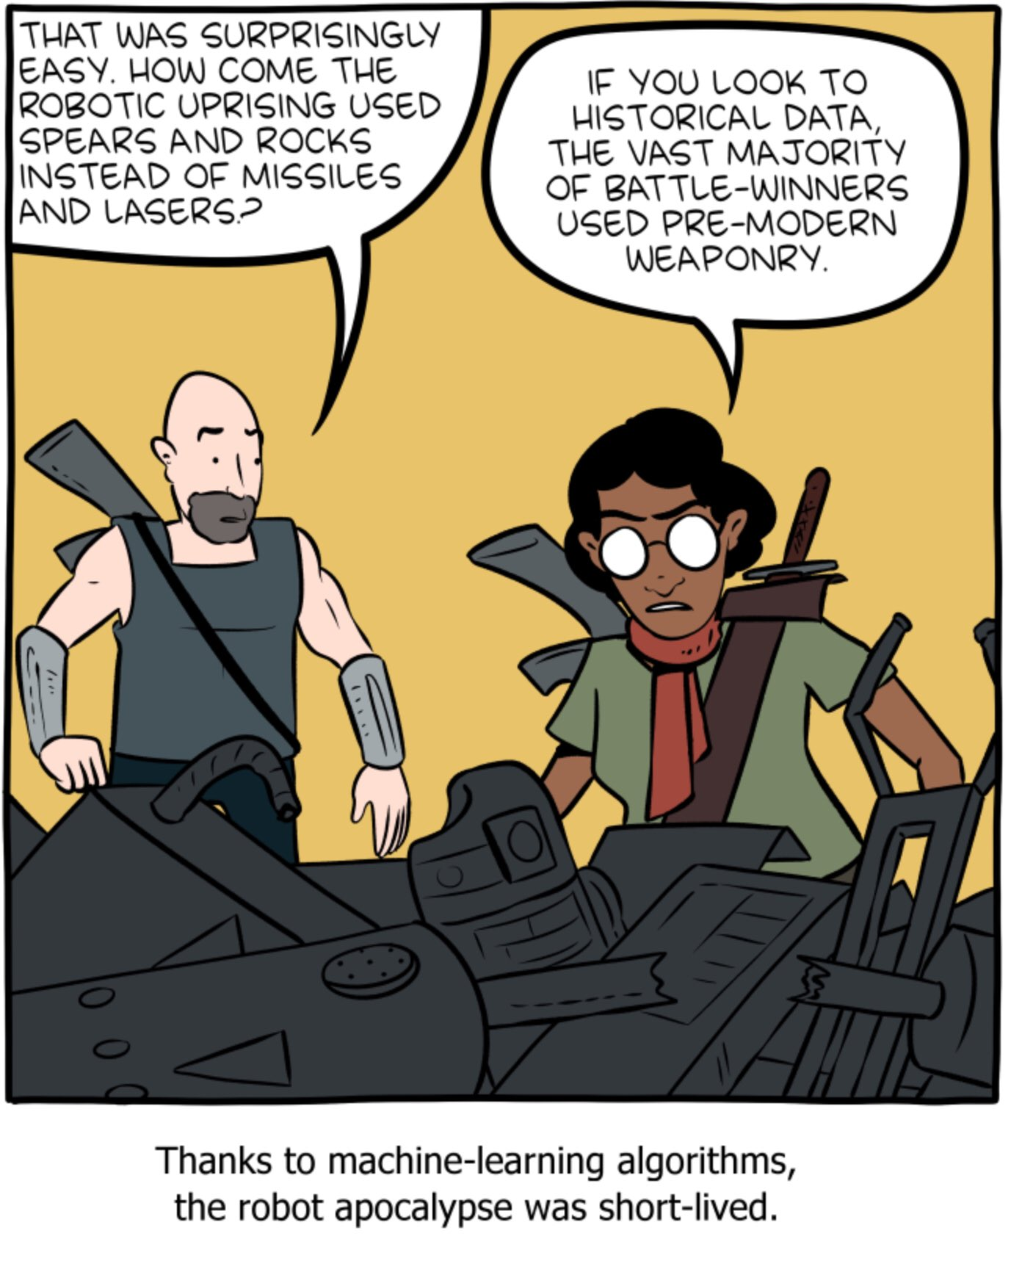
Final Thoughts
Remember Machine Learning relies on Data
Your models will behave as the training data indicates
If your data is flawed your model will be flawed
The more complex your application, the more comprehensive your data needs to be

Slide 26
Next Time
Begin discussing the machine learning process
Introduction to Scikit Learn
The steps to training machine learning models
Data Preprocessing
Remember Homework 5 is due on (03/06) before class

